Slide 1
Design Patterns

Slide 2
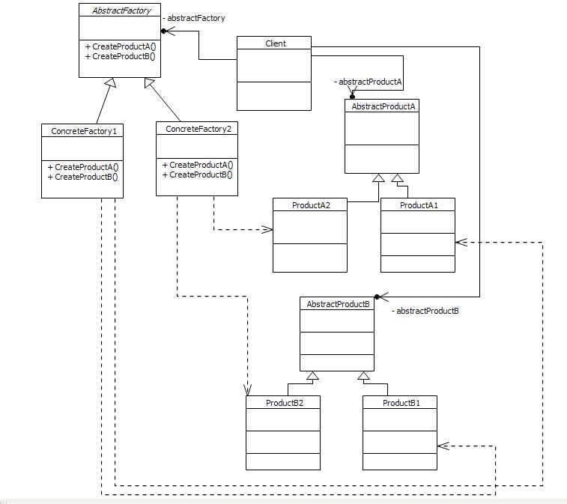
Abstract Factory
provides an interface for creating families of related or dependent objects without exposing their concrete classes.

Slide 3
Abstract Factory - Structure
AbstractFactory
offers the interface for creating products of different families;
CreateProductA() is an abstract method that will deliver products of family A, concrete products derived from base A
CreateProductB() is an abstract method that will deliver products of family B, concrete products derived from base B
ConcreteFactory
Implements the Abstract Factory methods that will create the concrete product objects
Each ConcreteFactory is specialized in delivering a certain concrete type of a product family; ConcreteFactory1 will know how to construct objects of type ProductA1 and ProductB1

Slide 4
Abstract Factory - Structure
AbstractProductA
Acts as a base class for products of family A
Defines the interface for the product family
ConcreteProductA
Implements the interface defined by AbstractProductA
Will be created by the corresponding ConcreteFactory1
Client
Uses only the interfaces defined by AbstractFactory and AbstractProduct

Slide 5
Abstract Factory - Principles
a system should be independent of how its products are created, composed, and represented.
a system should be configured with one of multiple families of products.
a family of related product objects is designed to be used together, and you need to enforce this constraint.
you want to provide a class library of products, and you want to reveal just their interfaces, not their implementations.

Slide 6
Abstract Factory - Implications
Concrete product classes are isolated from the client; client never uses the new operator to instantiate a concrete product; client never uses a concrete implementation directly
The responsibility of creating concrete objects belongs to the corresponding factory
The factories may be switched without effort; e.g. a configuration parameter can tell which concrete factory should be instantiated
It is easy to change products families; use another concrete factory

Slide 7
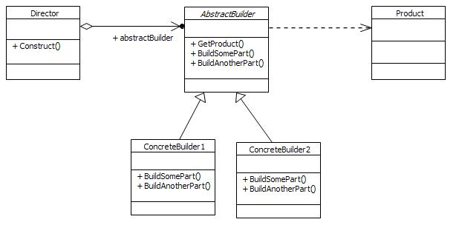
Builder
separates the construction of a complex object from its representation allowing the same construction process to create various representations.

Slide 8
Builder - Structure
AbstractBuilder
Offers an interface for creating parts of a complex product
BuildSomePart() and BuildAnotherPart() are abstract methods that enable the construction of various parts
Offers an interface for retrieving the built product
ConcreteBuilder1
Implements the interface described by AbstractBuilder; gives specific forms to the parts built;
Product
A complex object; before use, various parts need to be built, only after all the parts are built the creation is completed and the object may be used
Director
Orchestrates the building of the product by instantiating a convenient builder and calling the creation of product parts; finally retrieves the completed product

Slide 9
Builder - Implications
The construction of the object is independent of how the various parts are built
There is not the case of product families but there is the case of a Product type having various representations
The AbstractBuilder hides the construction process
To change the representation a new ConcreteBuilder must be created
Offers a fine control over part building

Slide 10
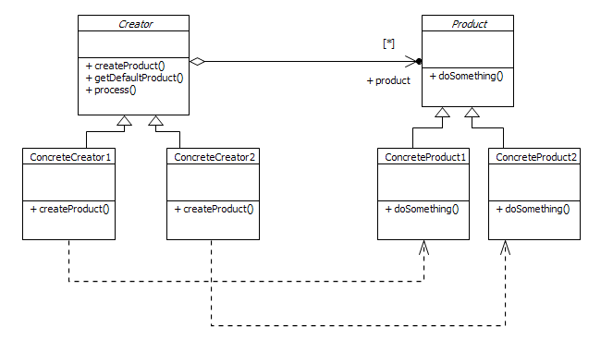
Factory Method
define an interface for creating an object, but let subclasses decide which class to instantiate
Factory Method lets a class defer instantiation to subclasses

Slide 11
Factory Method - Structure
Creator
Defines an interface for creating objects of type Product
createProduct() is the factory method
getDefaultProduct() is a method for creating a default Product of a certain concrete Type
Product
defines the interface exposed by product objects
ConcreteProduct
implements the interface exposed by its base class
ConcreteCreator
implements the interface defined by the Creator
creates ConcreteProduct objects

Slide 12
Factory Method - Structure
the concrete types of objects are hidden to the client
the client doesn’t need to know the concrete type of product
as opposed to the AbstractFactory, the Creator may also use the product in his own interest; The AbstractFactory is a class for creating Products; The Creator from the FactoryMethod is a class with a method for creating products, having additional functionality.

Slide 13
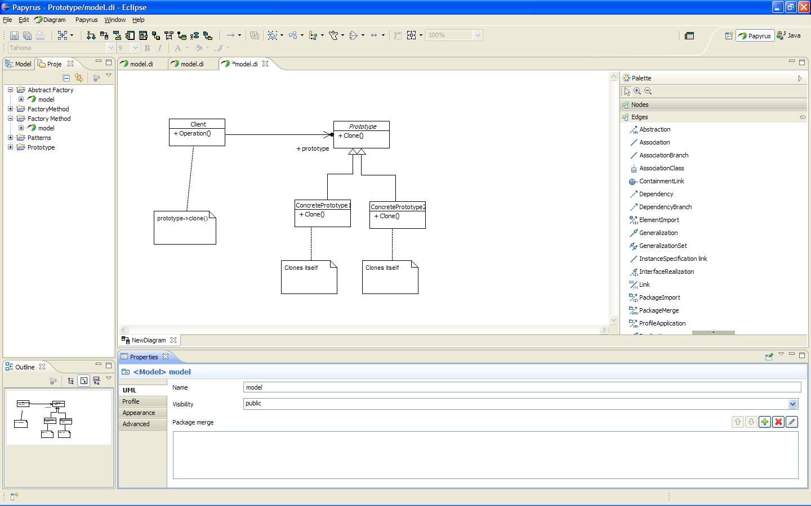
Prototype
specify the kinds of objects to create using a prototypical instance, and create new objects by copying this prototype

Slide 14
Prototype – Structure
Prototype
defines an interface for cloning itself
ConcretePrototype
implements the cloning operation; creates an object of the same type with the same internal state
Client
uses a prototype to create new ConcreteObjects from the prototype

Slide 15
Protorype - Implications
useful when there are only a few states for the ConcretePrototype ; already existing instances may be used to instantiate clones without reconstructing the object
various implementations are possible: deep / shallow copies
available in various languages: copy constructors, ICloneable interfaces, etc.

Slide 16
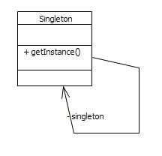
Singleton
Ensure a class has only one instance, and provide a global point of access to it.

Slide 17
Singleton
In order to implement such requirement, the Singleton class contains the following:
The attribute holding the unique instance, called instance; the instance’s visibility is set to private, in order to prevent direct access to the instance; also the scope of this attribute is set to classifier, this making it a static member in the class;
A private constructor; objects of type Singleton are not intended to be instantiated from other classes
A public operation at classifier scope (class level operation) that permits access to the unique instance, getInstance, implemented as a static method;

Slide 18
Singleton
SimpleSingleton is a simple implementation of the pattern using static members. These ensure the creation of the instance from the very start of the program or load of the shared library and continuous existence until the exit/unload.
LazySingleton offers the same functionality but it implements the case when the instance is not created until the first call to the getInstance method . This may be useful for memory reasons.

Slide 19
Singleton
ThreadSafeLazySingleton is an improved LazySingleton used in multithreading applications. It is necessary to ensure that only one call to the getInstance method done from different threads performs the instantiation and the rest of the calls return only the already existing object. In this case a mutex is used to synchronize the calls at getInstance method level. In the given example a time consuming operation is simulated in the private constructor such way if multiple threads call the getInstance, then they are forced to wait the instantiation of the object. It is observed from the output that the calls are synchronized.

Slide 20
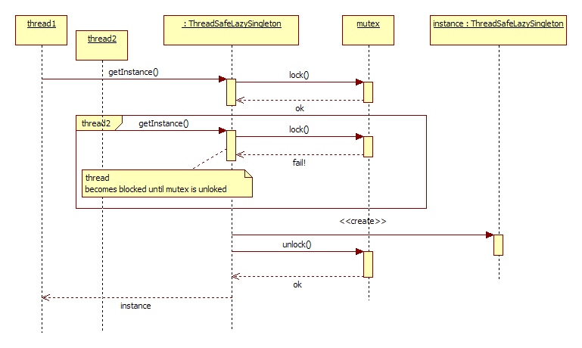
Singleton – Thread Safe Lazy Singleton

Slide 21
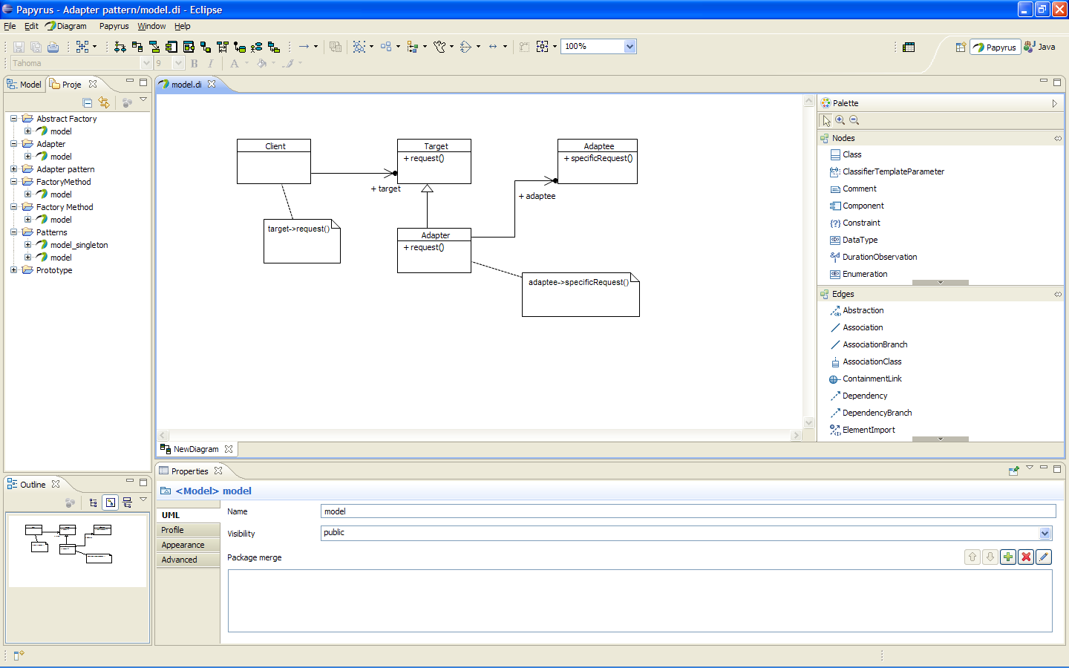
Adapter/Wrapper
Structural pattern
converts the interface of a class into another interface clients expect.
lets classes work together that could not otherwise because of incompatible interfaces.

Slide 22
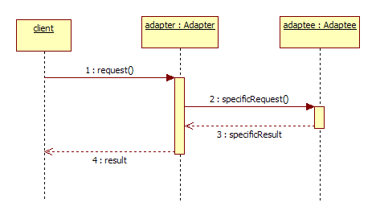
Adapter – Structure
Target
Offers the interface to be used by the client
Adapter
Implements the interface of the Adaptee to the Target interface
Adaptee
Supports a specific request that is not compatible with the target request

Slide 23
Adapter - Implications
There may be existing classes that are difficult to rewrite but cannot be used as they are
Different adapters can adapt heterogeneous adaptees; the target interface is unique
The client is not interested how the result is obtained; the backend mechanisms are transparent for the client

Slide 24
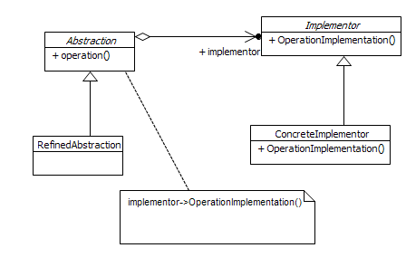
Bridge
Decouples an abstraction from its implementation allowing the two to vary independently.

Slide 25
Bridge - Structure
Abstraction
abstract class defining the interface
RefinedAbstraction
Extends the interface defined by abstraction
Inherits the operation()
Implementor
Defines the interface for classes that hold concrete implementations
ConcreteImplementor
Implements Implementor interface and defines the concrete implementation

Slide 26
Bridge - Implications
Various abstractions can use various implementations
There are two independent regions: the inheritance tree form Abstraction and the inheritance tree from Implementor; these are independent and operation implementations can be combined easily

Slide 27
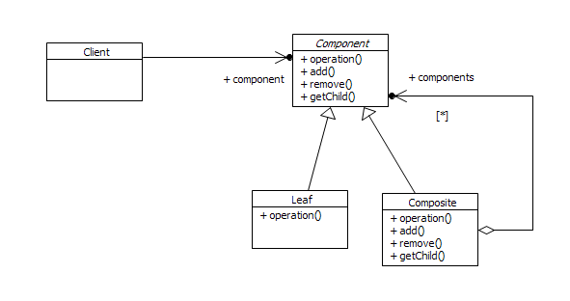
Composite
Compose objects into tree structures to represent part-whole hierarchies. Composite lets clients treat individual objects and compositions of objects uniformly.

Slide 28
Composite - Structure
Component
Defines the common interface to all objects in composition
Leaf
Represent the primitive objects in composition
Do not have children
Composite
Has children implemented as a collection of reference to the base type
Is able to store/remove children
Client
Uses the Component interface to manipulate objects in composition

Slide 29
Composite - Implications
The client can use arbitrarily large compositions in a transparent way
The client is unaware of the size of the composition
More Component derived classes may be added without changing the client

Slide 30
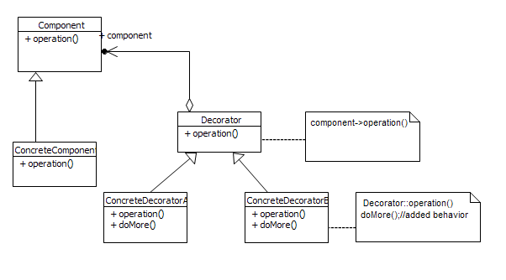
Decorator
Attaches additional responsibilities to an object dynamically keeping the same interface. Decorators provide a flexible alternative to subclassing for extending functionality.

Slide 31
Decorator - Structure
Component
Operation() is the interface for objects with dynamically added behaviors
Decorator
Holds a reference to the Component the dynamical behavior is added to
Implements the operations from Decorator interface; calls the operation() from the component it decorates
ConcreteDecorator
Holds the supplemental behavior
Implements operation() where decorated component’s behavior is invoked by calling to the base class implementation; this is decorated with additional behavior doMore()

Slide 32
Decorator - Implications
Adds behaviors dynamically without affecting the decorated classes
Avoids large inheritance trees
Class inheritance is statically defined; decorator makes it dynamic

Slide 33
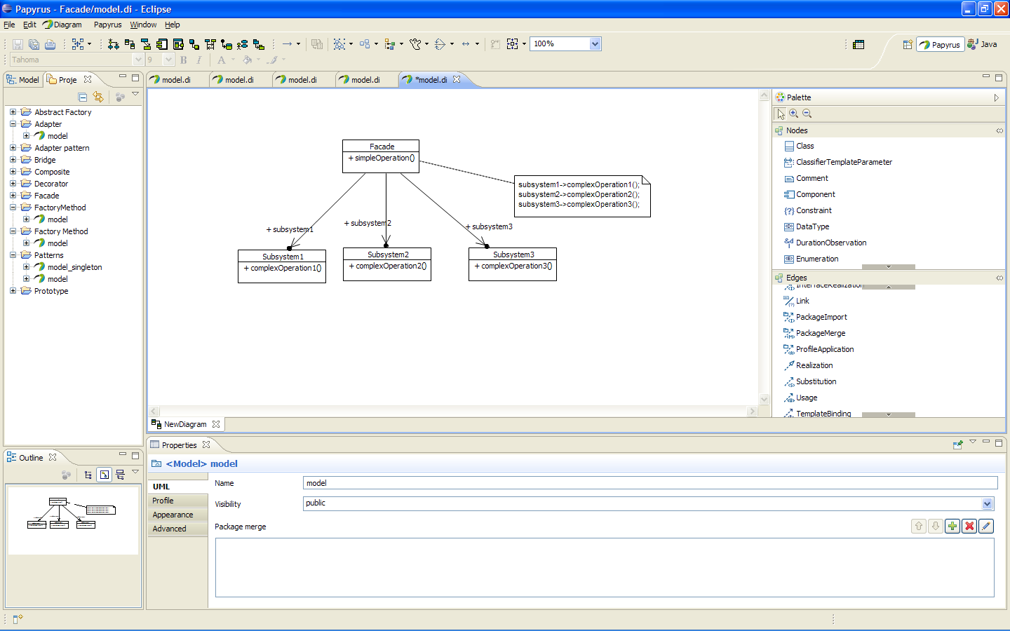
Facade
provide a unified interface to a set of interfaces in a subsystem. Facade defines a higher-level interface that makes the subsystem easier to use.

Slide 34
Facade - Structure
Facade
Defines the interface the client needs to use; the interface of Façade further makes calls to appropriate subsystems
Subsystem
implements particular functionality;
handles work assigned by the Facade object

Slide 35
Facade - Implications
The subsystem is unaware of the façade. It just performs its operations and the façade is a client for it
Clients are unaware of the subsystems, the façade only offers a simple interface
Usually the subsystems are very complex
The client is dependent on the façade; the façade takes over the dependencies with the subsystems
The subsystem and the client can be developed independently.
Subsystem classes are not necessarily related

Slide 36
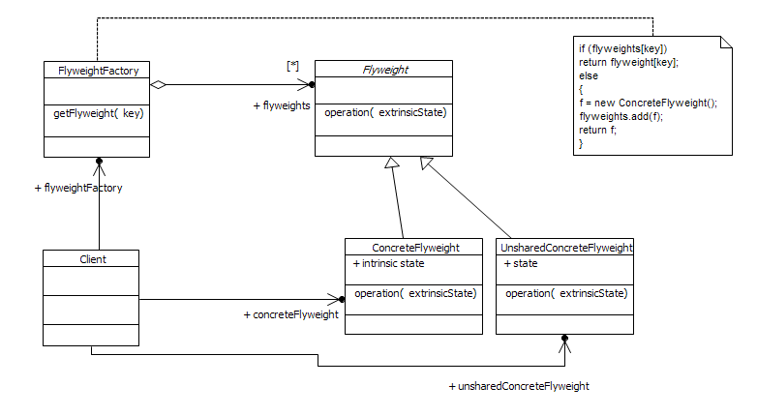
Flyweight
use sharing to support large numbers of similar objects efficiently.

Slide 37
Flyweight – Structure
Flyweight
Abstract class that provides an interface to operate on extrinsic state held by the client
ConcreteFlyweight
Defines the intrinsic state
Implements the concrete operation on the extrinsic state
Intended to be shareable
Created only by the factory
UnsharedConcreteFlyweight
Implements the concrete operation for the extrinsic state
Is not intended to be shareable
Created directly by the client
FlyweightFactory
Creates and holds shareable flyweight objects
getFlyweight() returns a new flyweight if it is not already defined, based on the search criterion, in this case, the key, or, if the flyweight exists, then it returns the existing object from the pool
Client
uses FlyweightFactory to obtain flyweight objects
stores/computes the flyweights extrinsic states
uses the flyweights via the operation() method.

Slide 38
Flyweight – Implications
useful when the client uses a large number of objects; to use flyweight, most of the object’s state must be made extrinsic; the extrinsic state must be easy to store by the client or must be easily deductable
flyweight replaces large groups of objects with only a few instances
object identity is not important; it is important the behavior expressed for the extrinsic state.

Slide 39
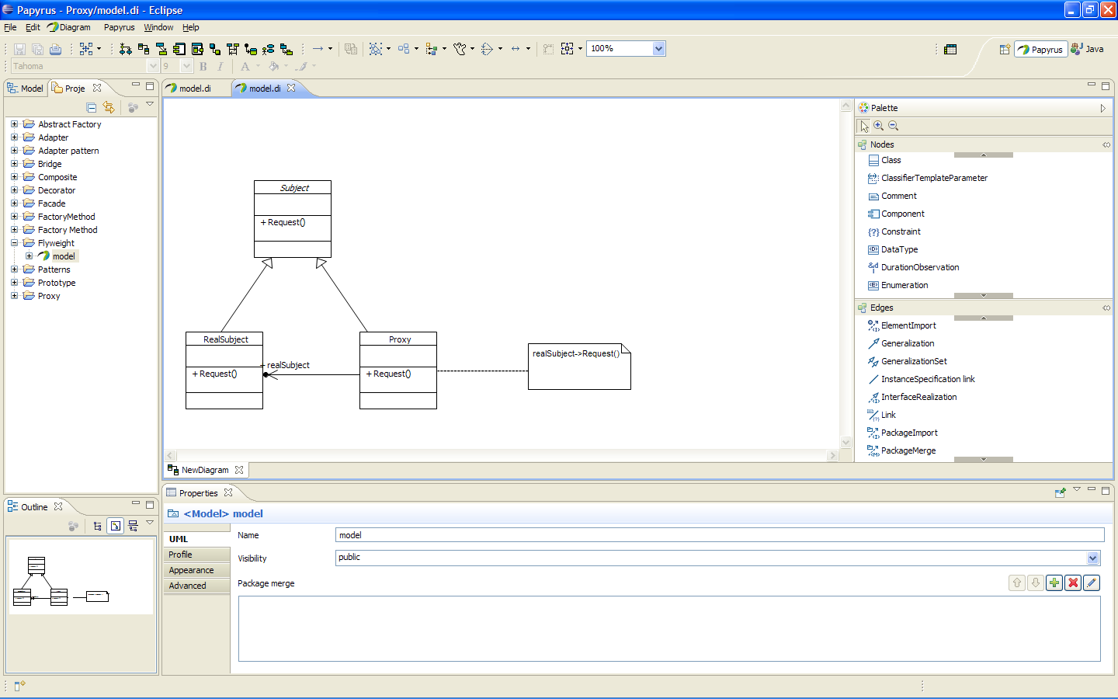
Proxy
provide a surrogate or placeholder for another object to control access to it.

Slide 40
Proxy - Structure
Subject
defines the interface for both RealSubject and Proxy
RealSubject
is the real object referenced by Proxy
implements the concrete functionality of the subject
Proxy
holds a reference to the real subject
implements the request() in which it makes a call to the real subject operation

Slide 41
Proxy - Implications
the proxy may be responsible for the creation/destruction of the real object
the proxy controls the access to the real subject
the real subject may be a remote object
usually found in C++ programming languages as smart pointers

Slide 42
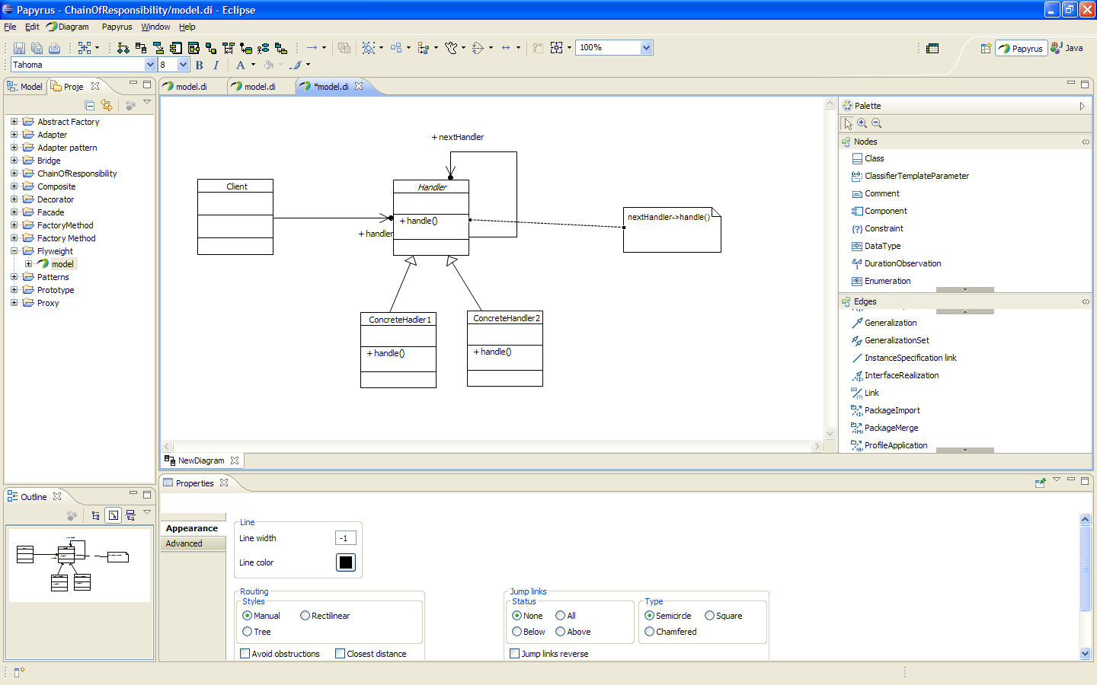
Chain of Responsibility
avoids coupling the sender of a request to its receiver by giving more than one object a chance to handle the request. Chain the receiving objects and pass the request along the chain until an object handles it.

Slide 43
Chain of Responsibility - Structure
Handler
interface for handling requests
holds a link to its successor like in a simple linked list
ConcreteHandler
handles the request in a particular fashion
if it can handle the request then performs the processing, if not, then forwards it to the next handler in the chain; also, depending on the implementation, after handling the request, can trigger processing from the successor
Client
launches a request to the first Handler in the chain

Slide 44
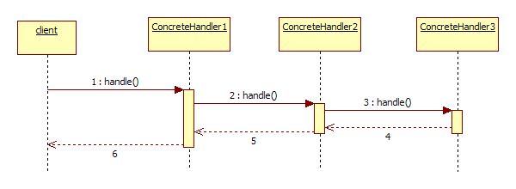
Chain of Responsibility - Structure

Slide 45
Chain of Responsibility - Implications
Fire and forget processing
more than one object can handle the request
this pattern reduces coupling between the client and each of the concreteHandler implementations; the coupling is at Client – Handler level
each of the Handlers has particular behavior
the processing chain is easily changeable

Slide 46
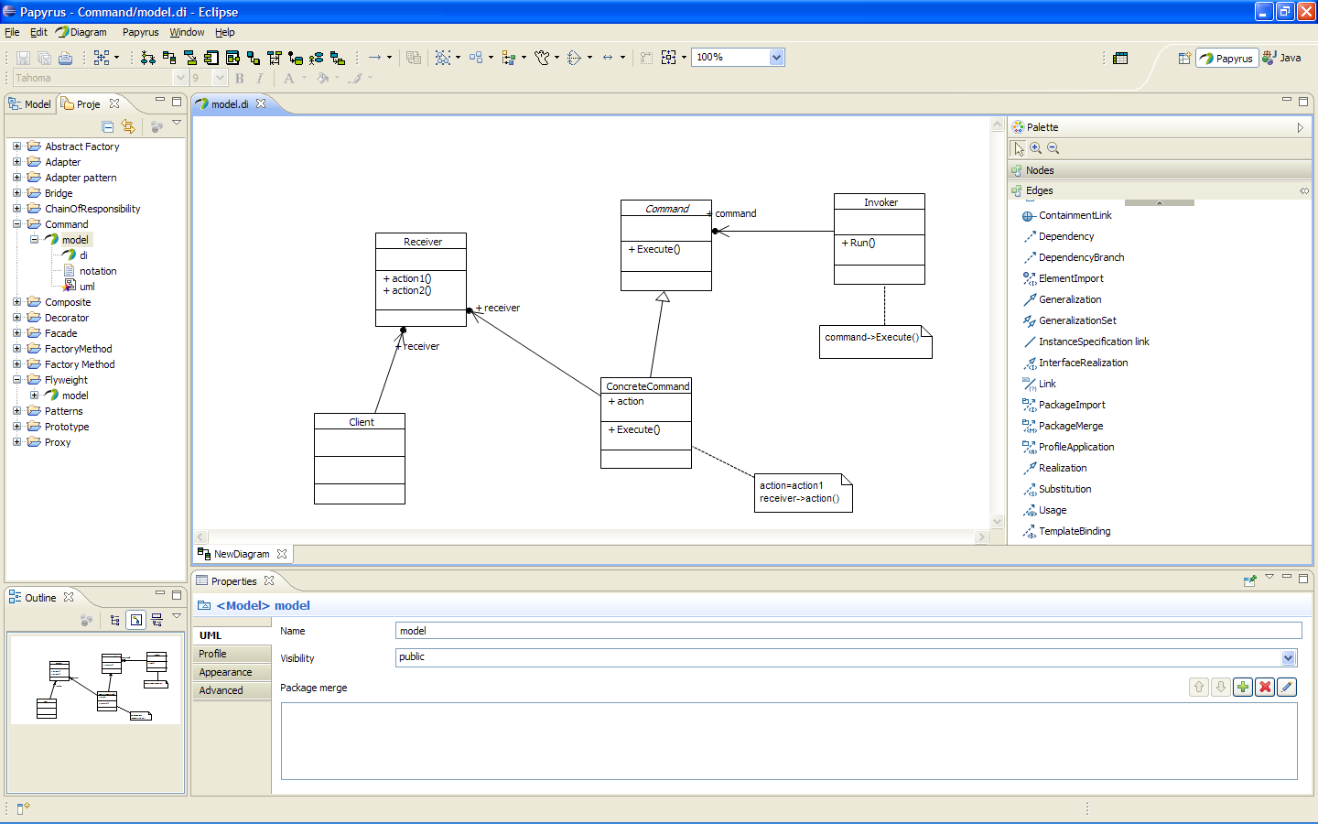
Command
encapsulates a request as an object, thereby letting you parameterize clients with different requests, queue or log requests, and support undoable operations.

Slide 47
Command - Structure
Command
defines the interface for executing an operation
ConcreteCommand
implements the interface to execute the operation by calling the corresponding action on the receiver
Client
creates the command and sets the receiver
Invoker
calls the command to execute the operation

Slide 48
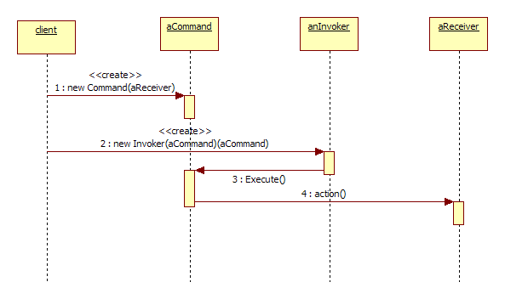
Command - Implications
the invoker is separated from the receiver

Slide 49
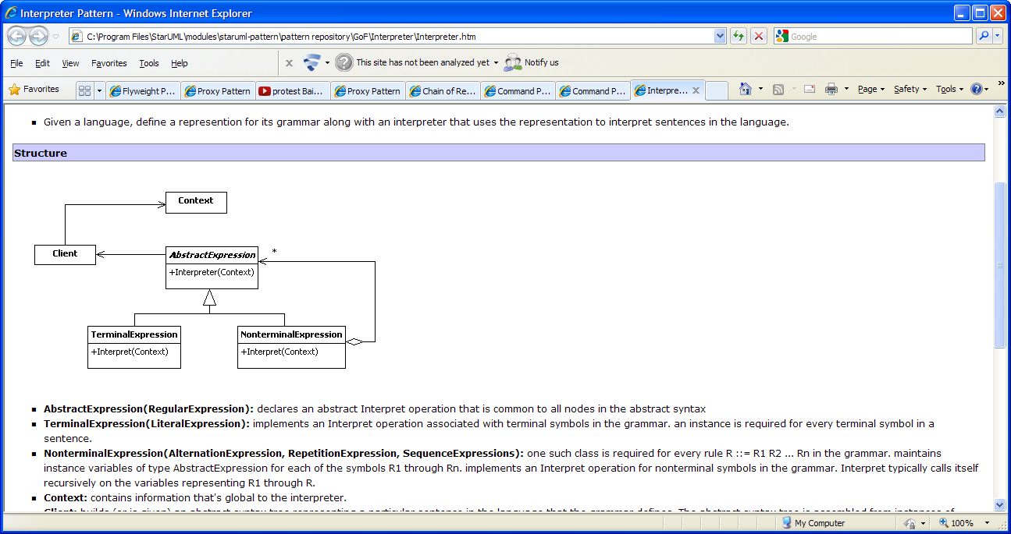
Interpreter
Given a language, define a representation for its grammar along with an interpreter that uses the representation to interpret sentences in the language.

Slide 50
Interpreter - Structure
AbstractExpression
defines an interface for interpreting the current node, common to all expression element types
TerminalExpression
implements the interpret operation for terminal nodes of the expression
NonterminalExpression
holds links to subexpressions that may be Terminal or Nonterminal
implements the interpret operation that calls interpret operation for each of the subexpression children defined;
Context
holds shared data to be used during interpretation
Client
holds a link to the first node in the expression tree
triggers the interpretation

Slide 51
Interpreter - Implications
used for expression evaluation
extensible
for difficult grammars becomes hard to maintain

Slide 52
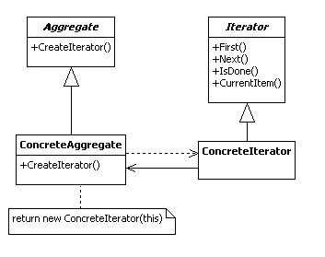
Iterator
Provide a way to access the elements of an aggregate object sequentially without exposing its underlying representation.

Slide 53
Iterator - Structure
Iterator:
defines an interface for accessing and traversing elements.
ConcreteIterator
implements the Iterator interface.
Aggregate
defines an interface for creating an Iterator object.
ConcreteAggregate
implements the Iterator creation interface to return an instance of the proper ConcreteIterator
holds and manages the collection of Items
Item
the class type for the elements in the collection held by ConcreteAggregate

Slide 54
Iterator - Implications
this pattern provides access to contained elements without showing the exact internal representation used inside the ConcreteAggregate
more iterators may be defined, for various traversal modes
implemented on various platforms, c++, .NET, Java as part of the collections packages

Slide 55
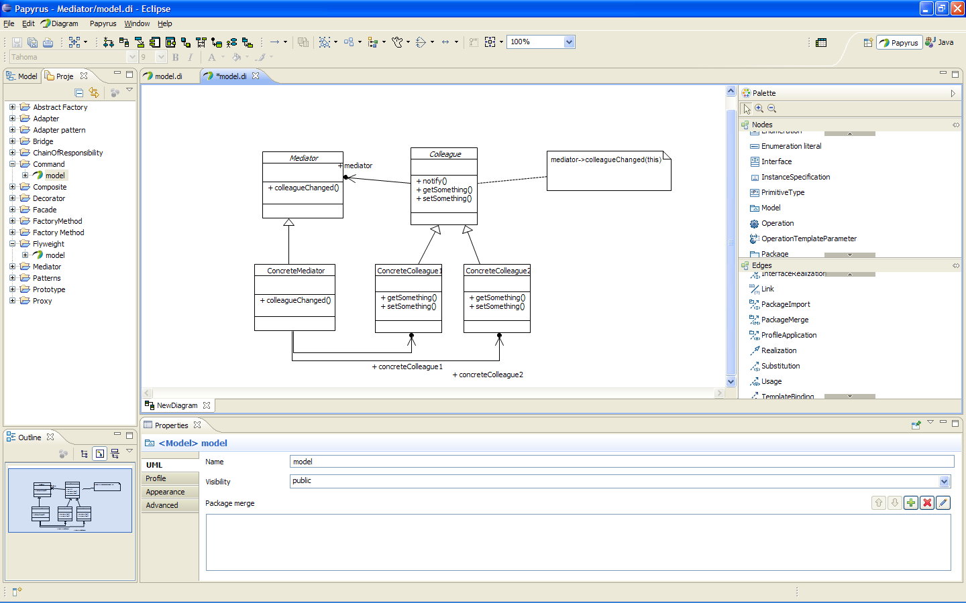
Mediator
defines an object that encapsulates how a set of objects interact.
promotes loose coupling by keeping objects from referring to each other explicitly, and it lets you vary their interaction independently.

Slide 56
Mediator - Structure
Mediator
defines an interface for communicating with Colleague objects.
ConcreteMediator
implements cooperative behavior by coordinating Colleague objects
holds references to colleagues
gets notified by the colleagues when their state changes
notifies
Colleague
each Colleague class knows its Mediator object.
each colleague notifies its mediator whenever it would have otherwise communicated with another colleague
offers interface for getting/setting the state
ConcreteColleague
implements the Colleague interface

Slide 57
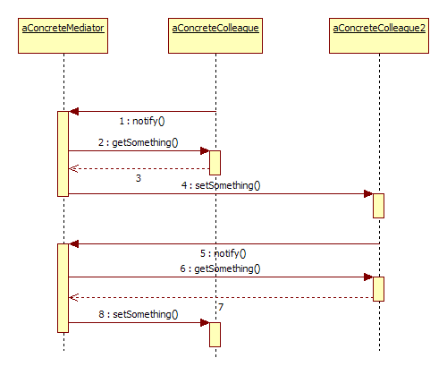
Mediator - Interactions

Slide 58
Mediator - Implications
the responsibility of handling state changes is taken by the mediator
reduces coupling between colleague components; without the mediator, the object could not be reused due to its dependencies with many other objects
the behavior is customizable in the mediator

Slide 59
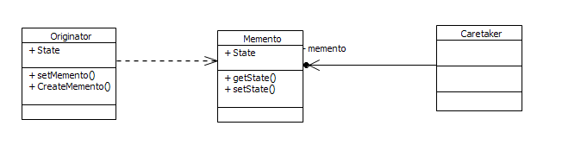
Memento
Without violating encapsulation, capture and externalize an object's internal state allowing the object to be restored to this state later.

Slide 60
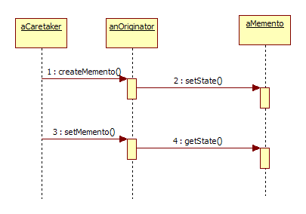
Memento - Structure
Memento
stores internal state of the Originator object.
Originator
creates a memento containing a snapshot of its current internal state.
uses a previously saved memento to restore its internal state.
Caretaker
is responsible for the management of the memento

Slide 61
Memento - Implications
Enables undo operations on the state of the originator
Only the Originator sets or loads the state of the memento
The caretaker is responsible only for triggering the memento events
Moves the responsibility of saving the state away from the originator

Slide 62
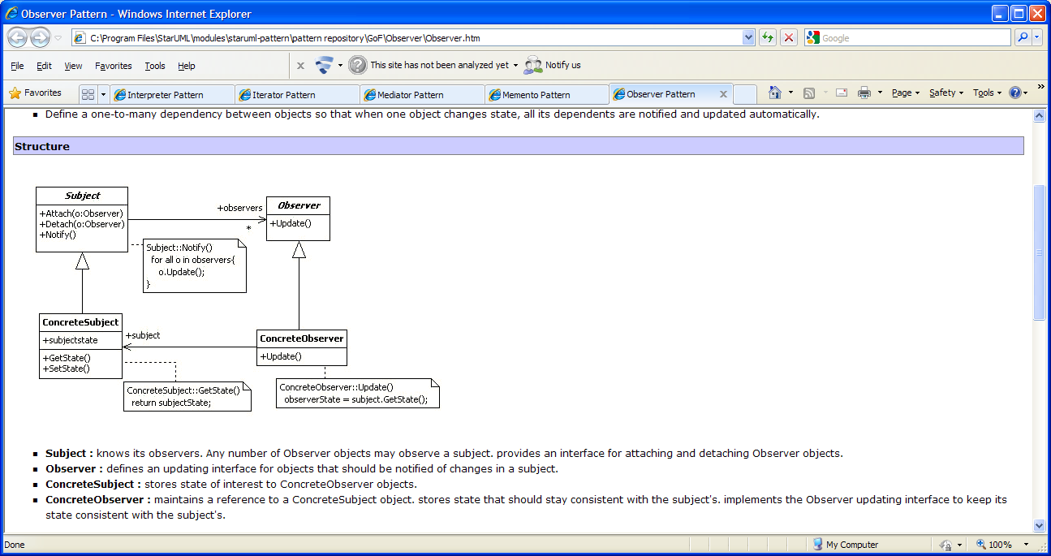
Observer – Publish/Subscribe
defines a one-to-many dependency between objects where a state change in one object results with all its dependents being notified and updated automatically.

Slide 63
Observer - Structure
Subject
Keeps a collection of its observers
provides an interface for attaching and detaching Observer objects.
Observer
defines an updating interface for objects that should be notified of changes in a subject.
ConcreteSubject
stores state of interest to ConcreteObserver objects.
ConcreteObserver
maintains a reference to a ConcreteSubject object
stores state that should stay consistent with the subject's
implements the Observer updating interface to keep its state consistent with the subject's

Slide 64
Observer - Implications
useful when you need to subscribe to an object’s changed state event and notify other objects on this change
the observers and the subjects are not coupled very tight
Subject implements an independent functionality
Observer implements the dependent functionality

Slide 65
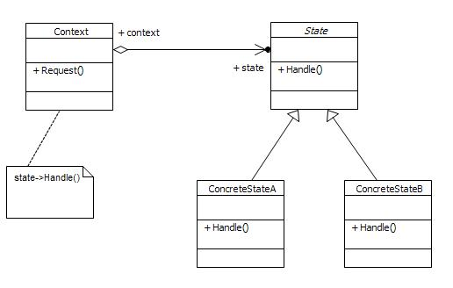
State
allows an object to alter its behavior when its internal state changes. The object will appear to change its class.

Slide 66
State - Structure
Context
Context object handles a request issued by a client
It also maintains an instance of the current state.
State
Defines an interface for applying the behavior from a concrete state
ConcreteState
Implements the specific concrete behavior for that state

Slide 67
State - Implications
Usually the context holds shared data across s the states. The request handler form the State class use the shared data in the processing.
State transitions can be made inside each state, or may be implemented at Context level
State objects are usually singletons
Repeated processing depending on various conditions can be split on a state basis

Slide 68
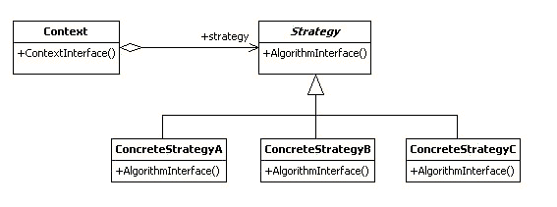
Strategy
defines a family of algorithms, encapsulate each one, and make them interchangeable. Strategy lets the algorithm vary independently from clients that use it.
Static structure is similar to the State pattern but here there are no transitions between states. Only one strategy is chosen to be applied.

Slide 69
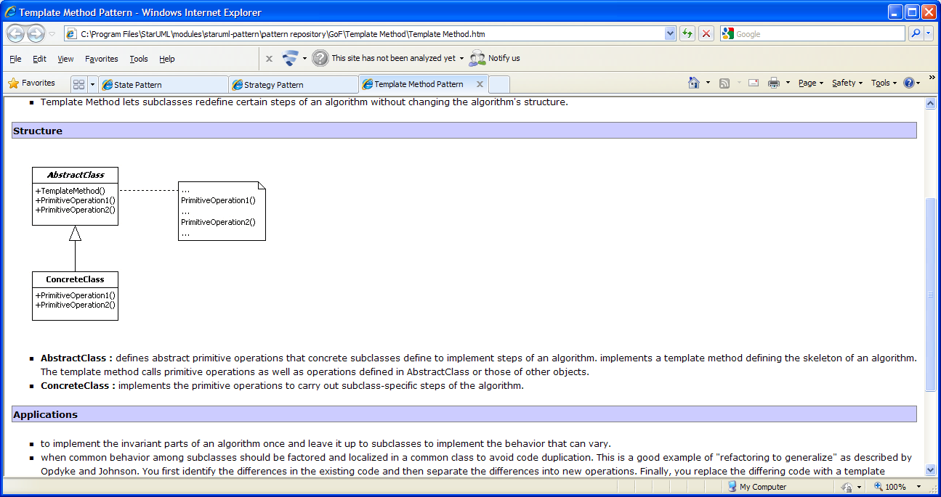
Template Method
Define the skeleton of an algorithm in an operation, deferring some steps to subclasses. Template method lets subclasses redefine certain steps of an algorithm without changing the algorithm's structure.

Slide 70
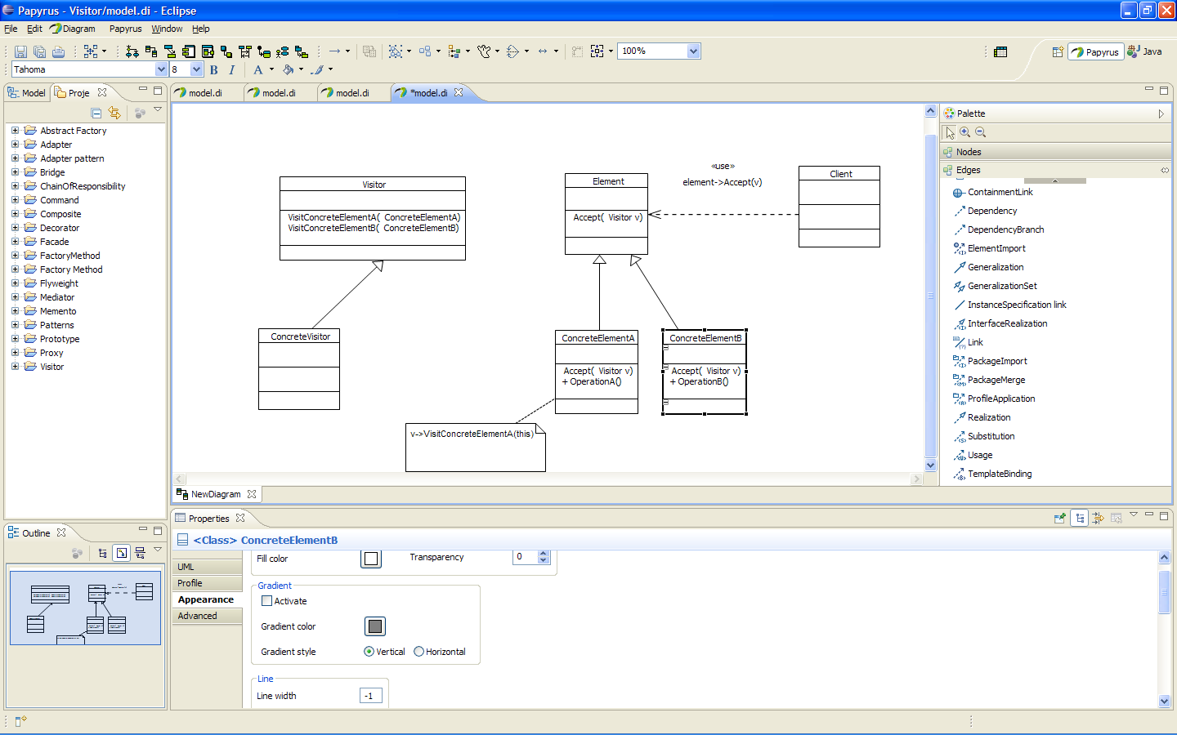
Visitor
Represent an operation to be performed on the elements of an object structure.
lets you define a new operation without changing the classes of the elements on which it operates.

Slide 71
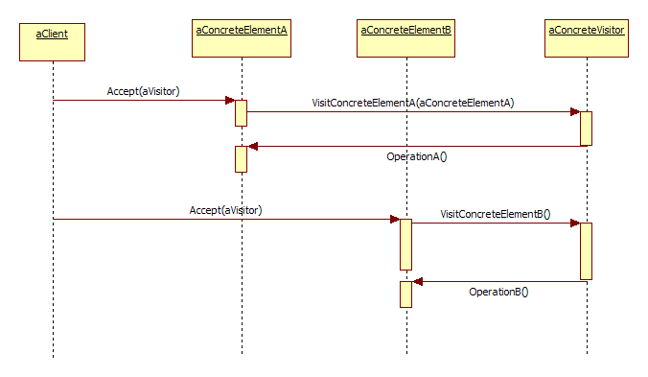
Visitor

